Slide 1



24-06-2026
Song Trend Lifecycle
Analysis
KAVIYA DHARSHINI

Slide 2


Key Insights
By Analyzing a year of Spotify chart data, this project addresses a critical gap in the music industry by shifting the focus from short-term viral hype to long-term audience retention. Instead of tracking why songs rise, it identifies the specific record labels, artists, and tracks that successfully sustain momentum and lock in dedicated listeners. This data-driven strategy uncovers patterns of genuine market endurance, offering vital, missing insights for a fast-paced Indian music market dominated by temporary, Reels-driven virality.
kaviyamahendran115@gmail.com

Slide 3
Performance of Music Labels in Streaming Platforms
Labels like T-Series, Sony Music, Zee Music Company, Saregama India Ltd, Universal Music India Pvt Ltd have been performing consistently. They release many songs, and their average number of songs staying on charts for all weeks is also huge. It is reaching a large audience and staying on charts for all weeks.
In terms of stats, these labels also have peak performance. For example, T-Series has 14 songs that consistently stayed on charts for all 54 weeks with highest streams and they are
Agar Tum Saath Ho (From "Tamasha"),
Hale Dil, Humdard (From "Ek Villain")
Humsafar (From "Badrinath Ki Dulhania")
Kaise Hua (From "Kabir Singh")
Mere Sohneya (From "Kabir Singh")
Pehli Dafa, Raabta,
Raanjhan (From "Do Patti")
Sajni (From "Laapataa Ladies")
Shree Hanuman Chalisa
Tujhe Kitna Chahne Lage (From "Kabir Singh")
Tum Se Hi
Ye Tune Kya Kiya
kaviyamahendran115@gmail.com

Slide 4

Chart Longevity by Label and Its Impact on Streaming Revenue
Longevity = Sustained streaming revenues.
Every week a song stays on the chart, it is being discovered by new listeners, added to playlists, and generating royalties. The labels such as Atlantic Records UK, The Weeknd/Lyric, Domino Recording, and Universal Music India have the highest average number of weeks on charts and long run, which became high chart longevity.
How Chart Longevity Affects Revenue:
More discovery by new listeners: Each extra week on the chart exposes the song to a new audience. More listeners = more streams.
Playlist additions: Songs that stay on charts longer get added to more playlists. Playlists drive repeat streams, which compound over time.
Sustained royalty generation: Streaming platforms pay per stream. A song on the chart for 54 weeks earns royalties for 54 weeks, instead of spiking for 2-3 weeks and disappearing.
kaviyamahendran115@gmail.com

Slide 5


The Problem of Artist Dependency
If one artist accounts for 70% of a label's charting songs, the label's entire chart presence collapses the moment that artist leaves, has a bad album, or faces controversy. That's a single point of failure.Labels with diverse artist rosters are structurally more resilient. If Artist A has a quiet year, Artists B, C, and D carry the chart presence.
Label Collapses Completely
These are the Labels that completely depending on one artist
kaviyamahendran115@gmail.com

Slide 6
Label Nearly Disappears
These are the Labels that depending on 2-3 artists
Label Severely Weakened
These are the Labels that depending on like 3-4 artists
kaviyamahendran115@gmail.com

Slide 7
Label Survives
These are the Labels that depending more than 5 artists
Among 64 music labels on this 54-week chart, only 8 labels survive without depending on a single artist, while 40 labels rely solely on one artist.
This creates high risk for those labels and shows how much label risk depends on artists.
kaviyamahendran115@gmail.com

Slide 8

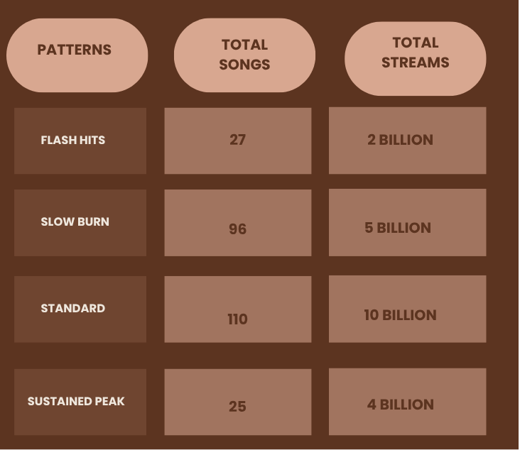
Lifecycle patterns
Among 635 songs,
The songs are classified into 4 patterns
Flash Hits - Songs that gain massive attention quickly but lose popularity just as fast.
Slow Burn - Songs that start with modest popularity and gradually build momentum over time.
Standard- Songs that follow a normal chart lifecycle with steady performance and moderate longevity.
Sustained Peak- Songs that reach high chart positions and maintain their popularity for extended periods.
kaviyamahendran115@gmail.com

Slide 9




THANK YOU
Linkedin
Github

